Slide 2
security protocol analysis
formal approaches
BAN logic
model checking
Paulson’s inductive method
the strand space method

Slide 3
strand space method

Slide 4
Contents
strand space theory
the difficulties, motivations, contributions
formalized strand space theory (in a theorem prover)
formalize and prove protocol properties
Needham–Schroeder–Lowe (NSL) protocol
Otway–Rees protocol

Slide 5

Preliminaries
Messages

Slide 6
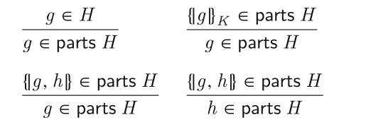
Preliminaries
operators parts
{g}k in parts H => g in parts H ???
H contains a penetrator’s initial knowledge and all messages sent by regular agents

Slide 7
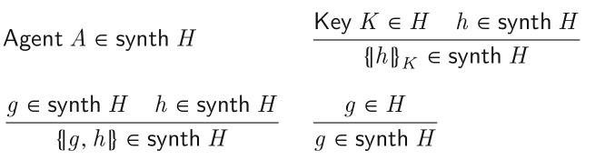
Preliminaries
operators synth
characterizes a penetrator’s ability to deduce knowledge from a message set H

